Slide 1
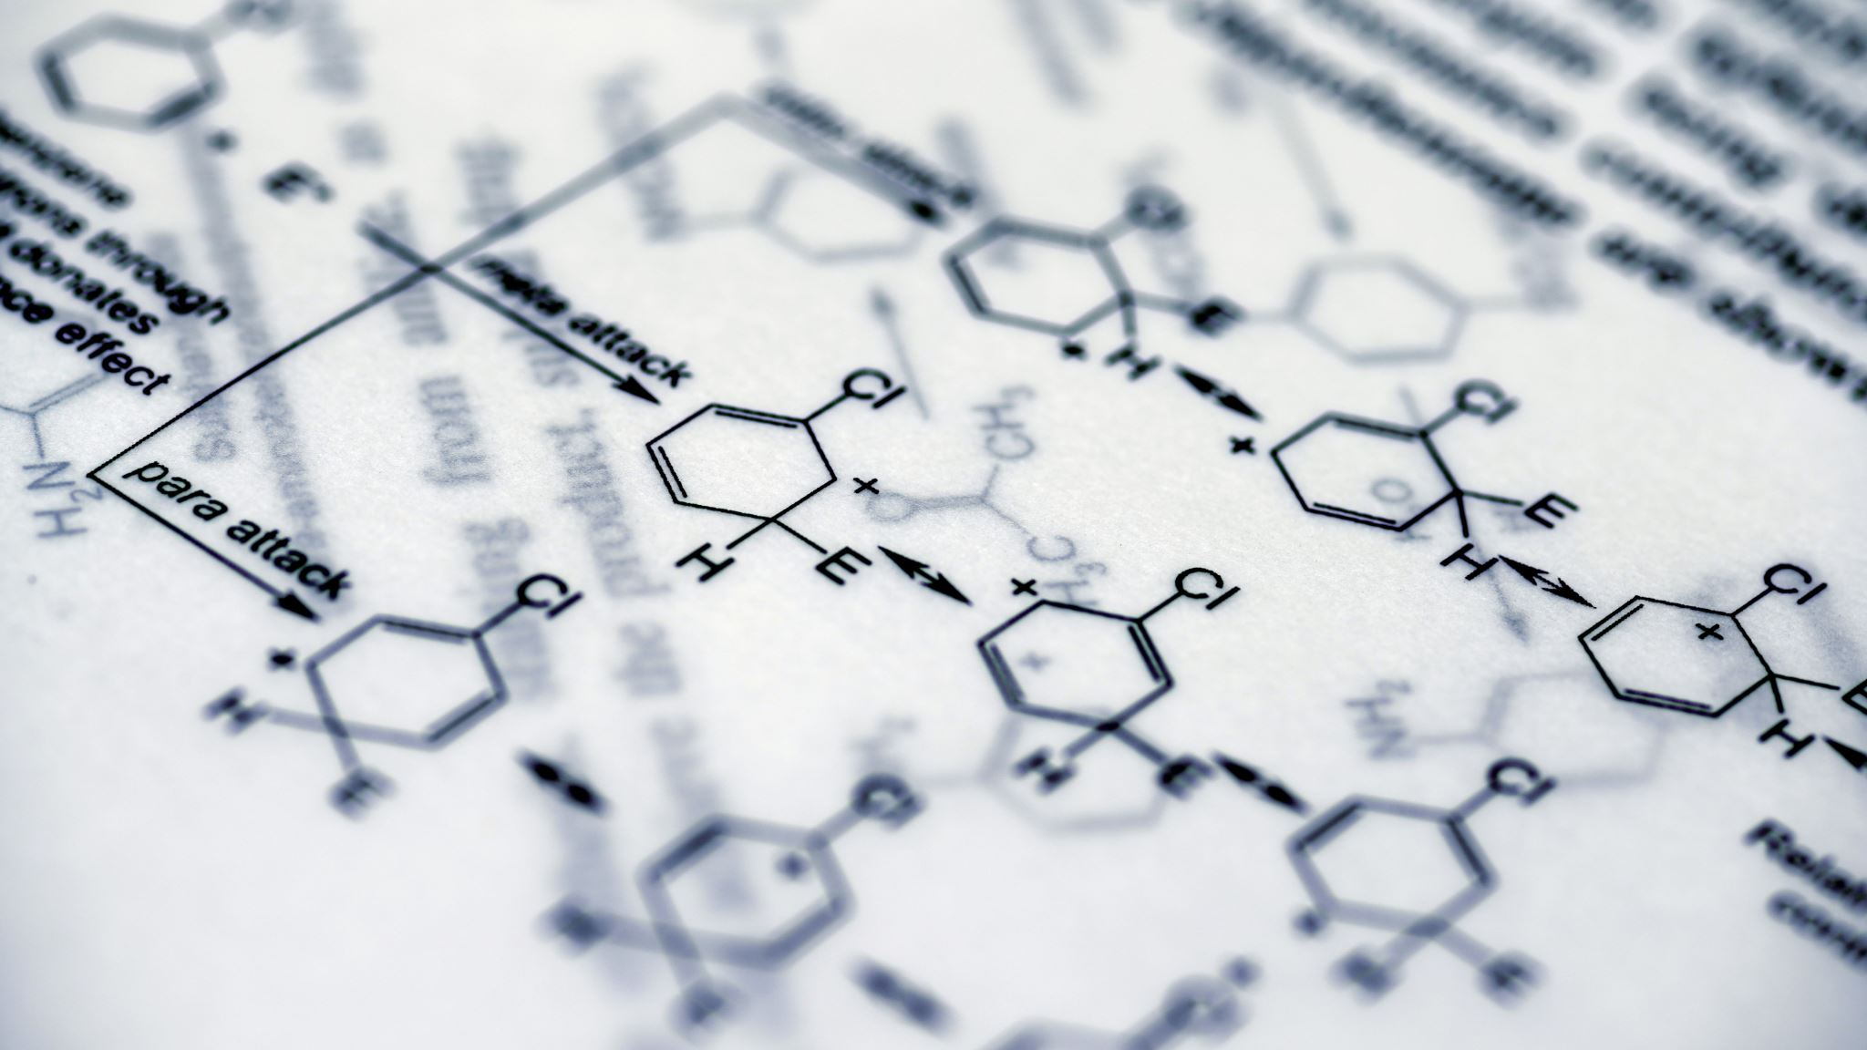
QSAR+Biodegradation
Nader Narcisse

Slide 2
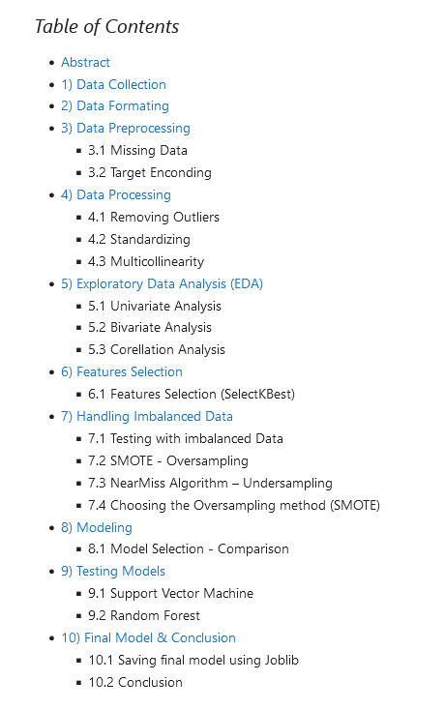
Introduction
Motivation:
School Project from the Data Analysis course in Python, taught as part of the ESILV master's degree.
This presentation is just a support for the notebook explaining the ins and out of the major encounters throughout this project.

Slide 3
Abstract
The Goal of this project is to train a reliable model to determine if a substance is biodegradable or not by using the QSAR biodegradation Data Set provided by UCI.
Here we are dealing with a classification problem. We are trying to predict a discrete value output: Degradable and Not-Degradable.
The challenge here personally is that I don't have a chemical engineering background. This project was definitely intriguing for me.

Slide 4
Data Collection
The QSAR biodegradation Data Set provided by UCI.
DATASET LINK : https://archive.ics.uci.edu/ml/datasets/QSAR+biodegradation

Slide 5
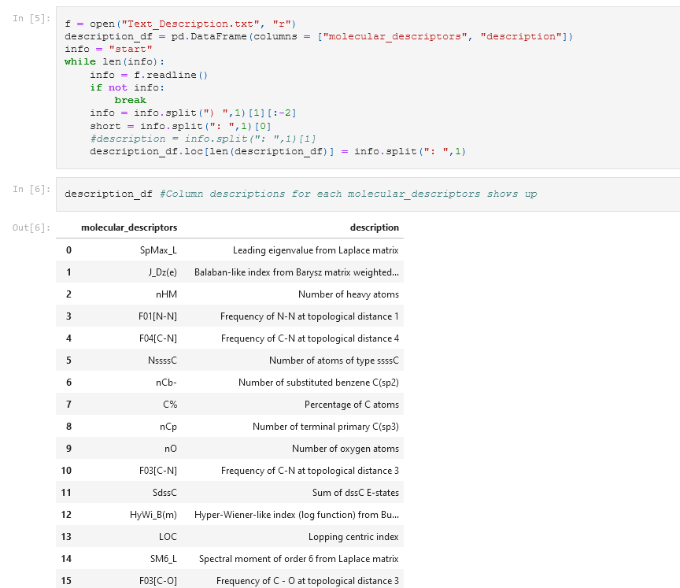
Data Formatting
I started formatting the data because the DataFrame was missing column descriptions.
I used the following script that opens the .txt file with the description that has been copied from the UCI web site. Then it was turned into a Panda DataFrame.

Slide 6
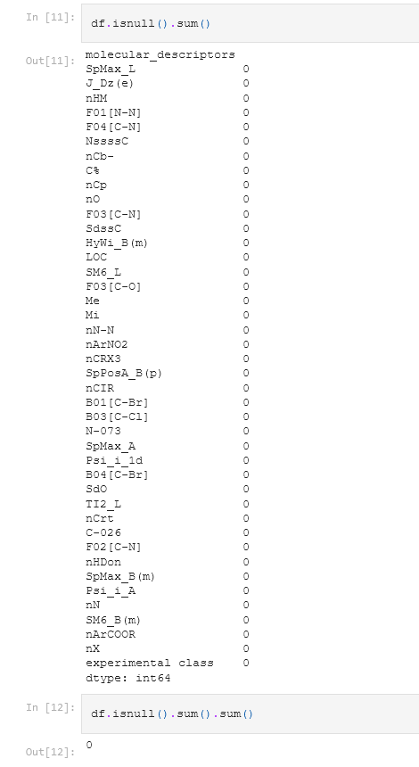
Data Preprocessing & Processing
I then made sure we have a clean dataset by :
- Checking missing Data
- Target Encoding
- Removing Outliers
- Standardizing
- Checking multicollinearity

Slide 7
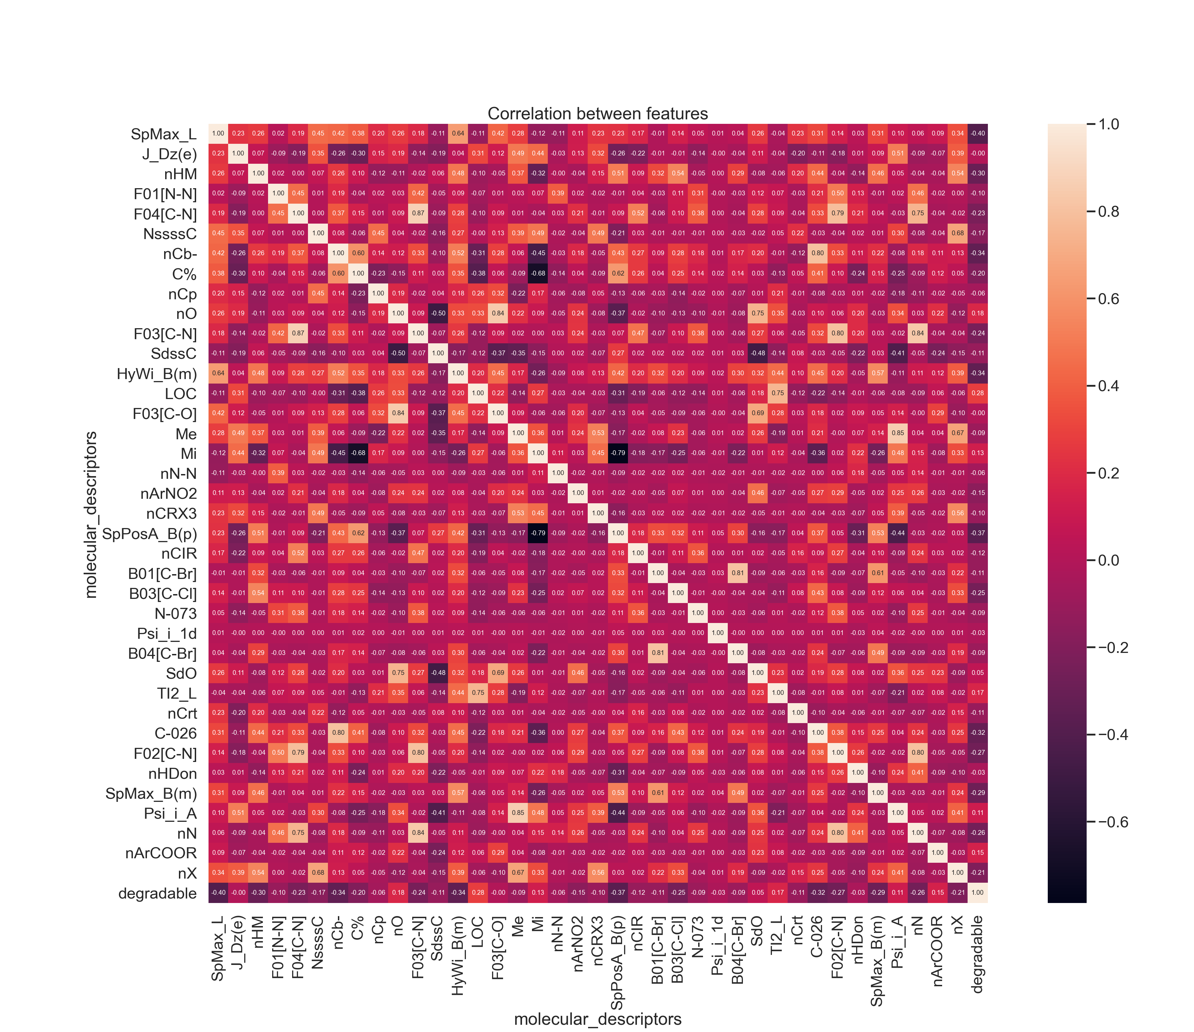
Exploratory Data Analysis (EDA) part-1
I proceeded with the EDA :
Univariate Analysis
Bivariate Analysis
Correlation Analysis

Slide 8
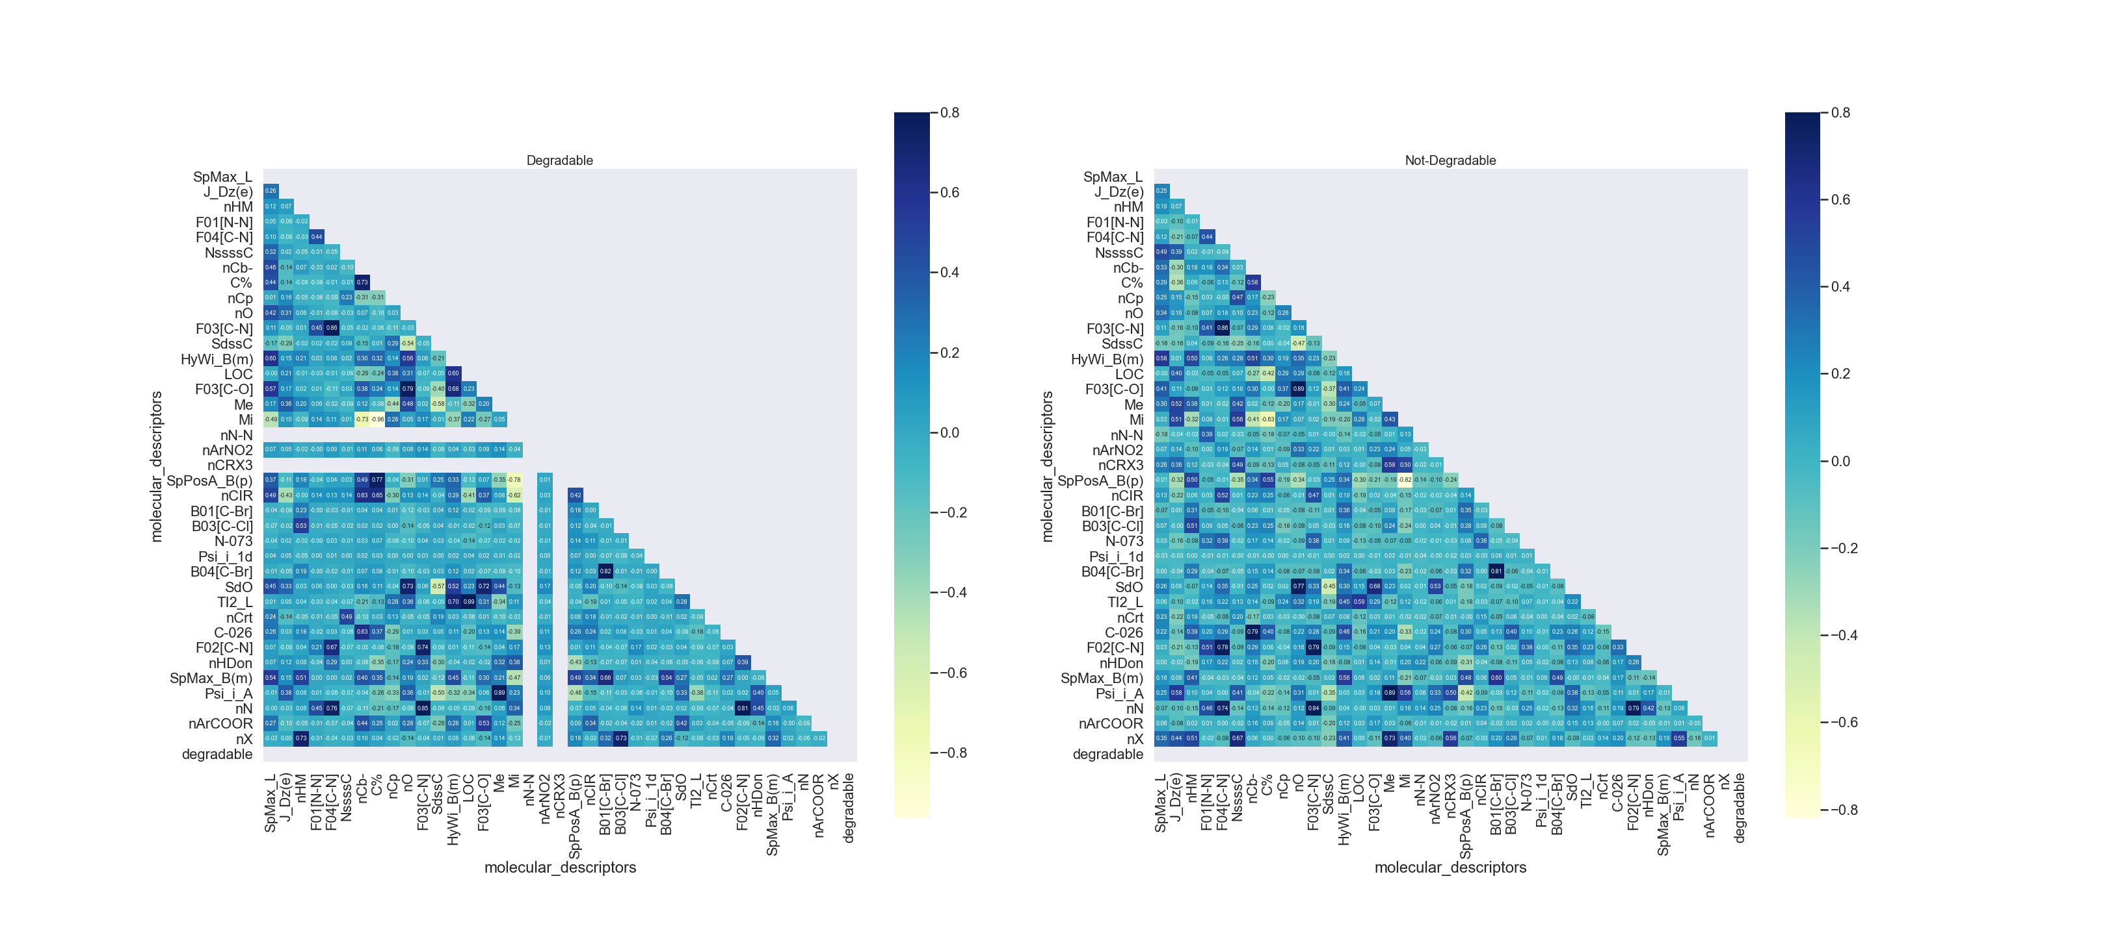

Slide 9
Exploratory Data Analysis (EDA) part-2
If there is no correlation between two variables, it means that the variables do not appear to be statistically related, that the value of one variable doesn’t increase or decrease in association with the increase or decrease of the other variable.
Here we see that nN-N and nCRX3 are two variables not correlated with the other variables for the Degradable class.

Slide 10
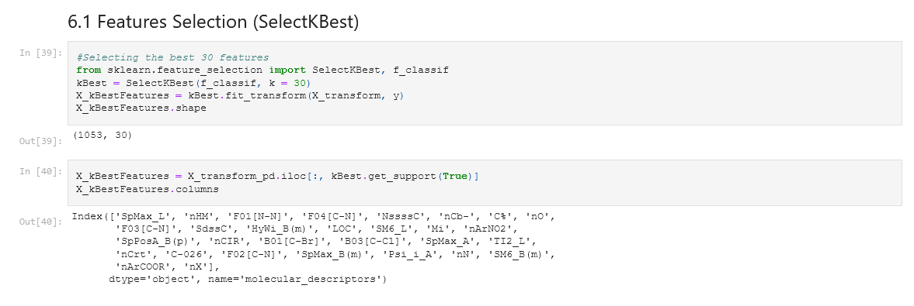
Features selection

Slide 11
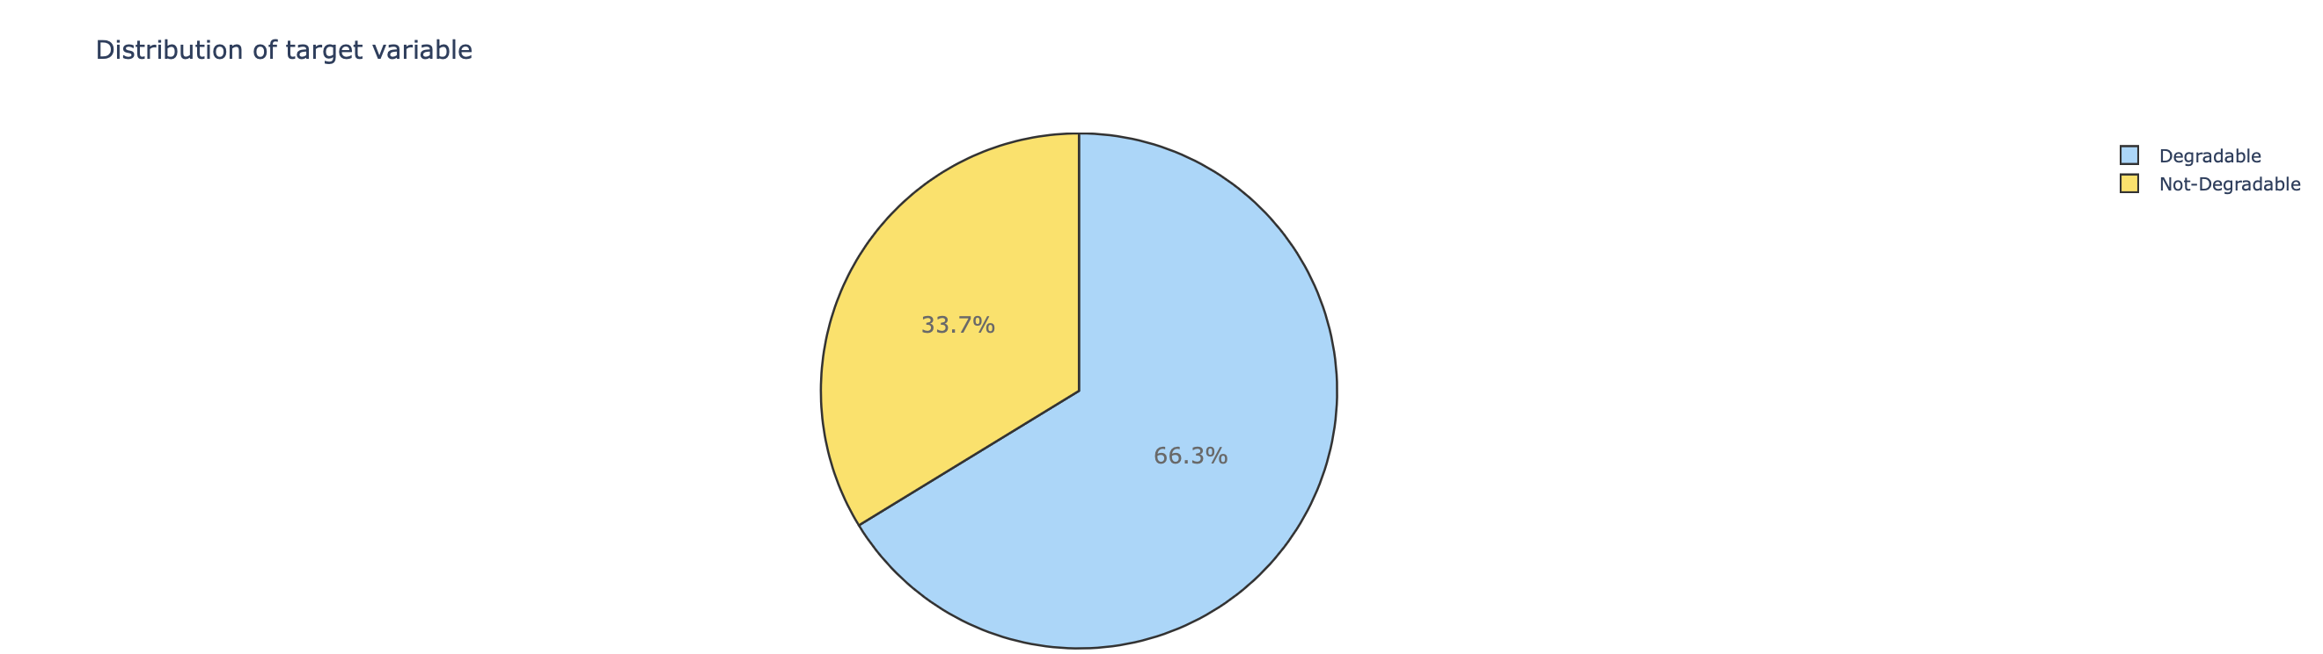
handling Imbalanced Data
We can see almost 2/3 of them are non-ready degradable while the rest of 1/3 of them are ready degradable.
There is a significant class imbalance. Class imbalance will lead to a bias towards the majority class. In this case we will perform an oversampling or undersampling method to equalize the data and choose one of them.

Slide 12
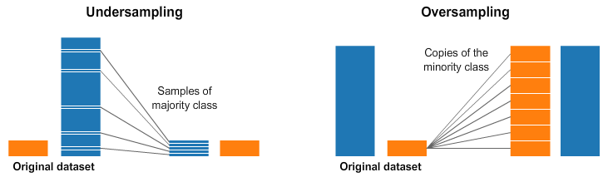
handling Imbalanced Data
Why are we doing this ?
With a greater imbalanced ratio, the decision function favor the class with the larger number of samples, usually referred as the majority class. Roughly speaking, weight of class begins depending on count samples.
Also, we can't use some metrics, like accuracy, if we have disproportion of samples. The objective here is to try to get the best accuracy on a reliable model.

Slide 13
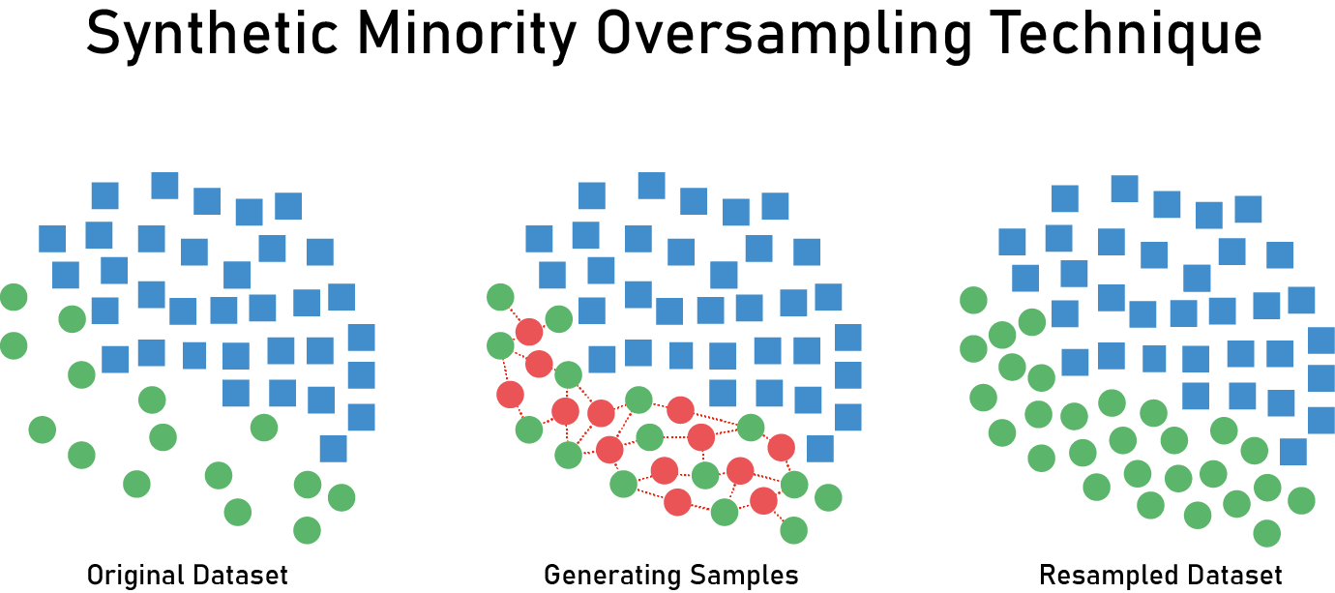
handling Imbalanced Data - SMOTE - Oversampling
Synthetic Minority Oversampling Technique (SMOTE) is an intelligent alternative to oversampling: rather than creating duplicates of the minority class, it creates synthetic data points that are relatively similar to the original ones. Using SMOTE, the model start detected more cases of the minority class, which will result in an increased recall, but a decreased precision.

Slide 14
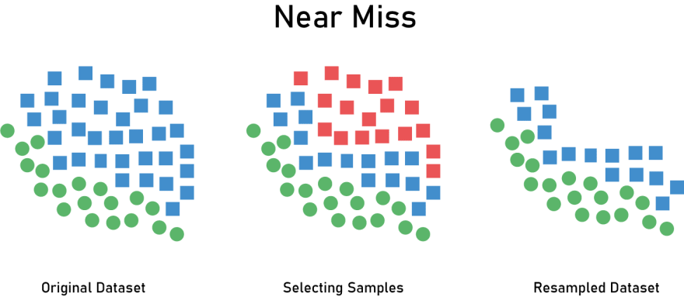
handling Imbalanced Data - NearMiss Algorithm - Undersampling
Near-miss is an algorithm that can help in balancing an imbalanced dataset. It can be grouped under undersampling algorithms and is an efficient way to balance the data. The algorithm does this by looking at the class distribution and randomly eliminating samples from the larger class.

Slide 15
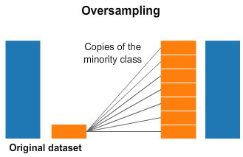
handling Imbalanced Data - Choosing the Oversampling method SMOTE
Since undersampling may discard the useful information which could be important for building good classifiers. I went with the Oversampling method with SMOTE.
Undersampling gets you less data, and most classifiers' performance suffers with less data.

Slide 16
handling Imbalanced Data - important note
I first used SMOTE and then split the data into train test split. The results were enthusiastic, the confusion matrix and classification report were pleasing. As I understood the problem with this approach is that the new synthetically created observations from the minority class in the training dataset might end up in the testing dataset. This in a way allows the algorithm to "cheat" since it learned from something similar and now is testing on almost very similar data points.
Which is understandable because if I first used SMOTE and then split the data into train test split is that the original sample in training (testing) and the synthetic sample (that was created based on this original sample) in the test (training) set.
When the model is in production, it’s predicting on unseen data. The main point of model validation is to estimate how the model will generalize to new data. If the decision to put a model into production is based on how it performs on a validation set, it’s critical that oversampling is done correctly.
To summarize: When you use any sampling technique you divide your data first and then apply synthetic sampling on the training data only. After you do the training, you use the test set which contains only original samples to evaluate.

Slide 17
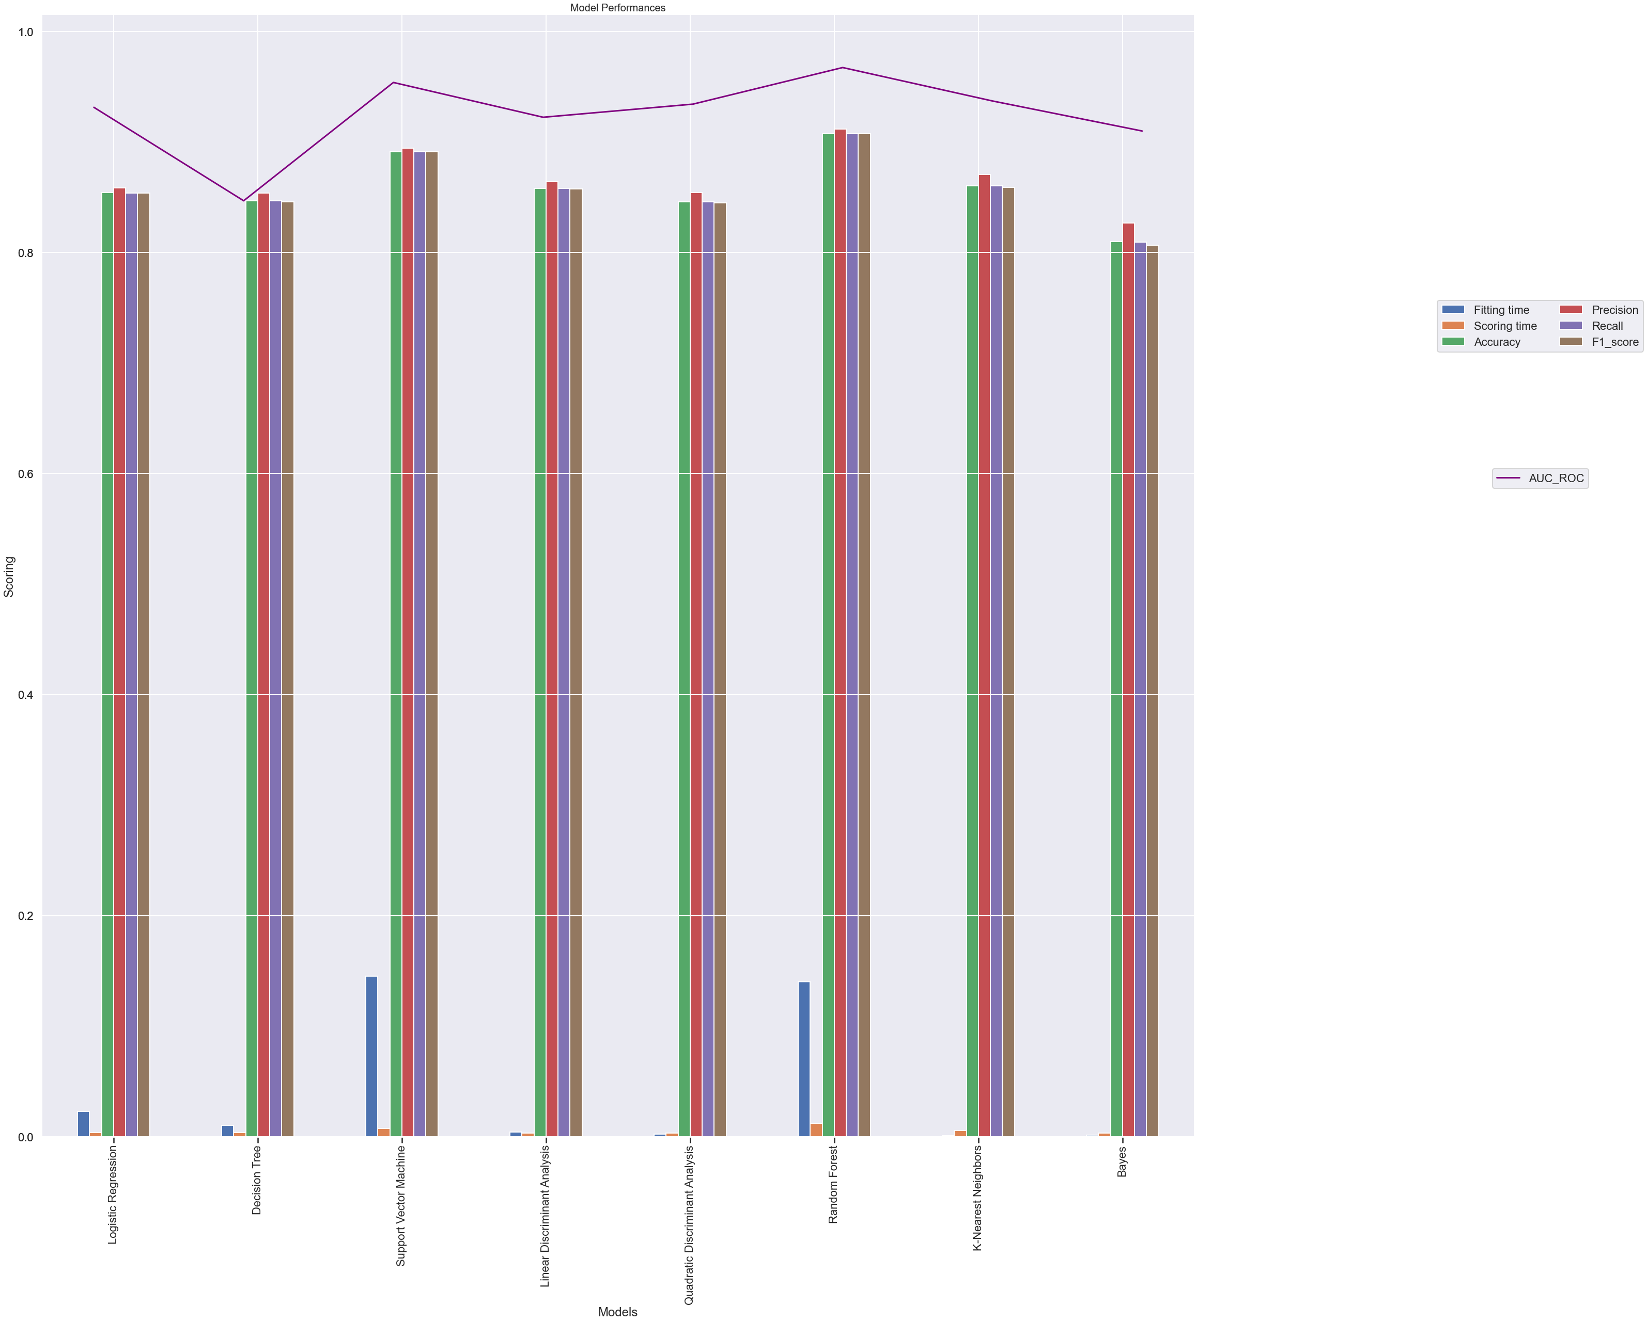
Model Selection - Comparison
As we can see in overall performance, the Random Forest and Support Vector Machine models are the best ones in this selection process, in the next step we will be using them for testing.
Note :
We are not necessarily looking for the best fit time but we see that the 2 best models in terms of performance are the ones with a bigger fit time.

Slide 18
Testing models
In this process, we modified the hyperparameter of each models to see how it performed by using GridSearchCV()
I am satisfied by the overall result of the Support Vector Machine (SVM) model with an accuracy of 89.24%
Note :
We need to check the accuracy difference between train and test set for each fold result. If my model gives me high training accuracy but low test accuracy my model is overfitting. On the other hand, if it does not give good training accuracy, my model is underfitting.

Slide 19
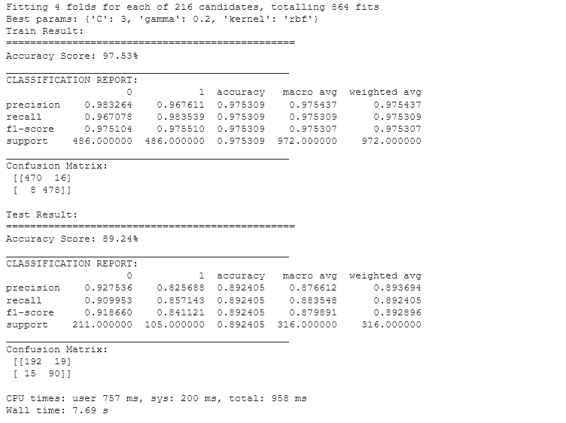
testing results - Support vector machine

Slide 20
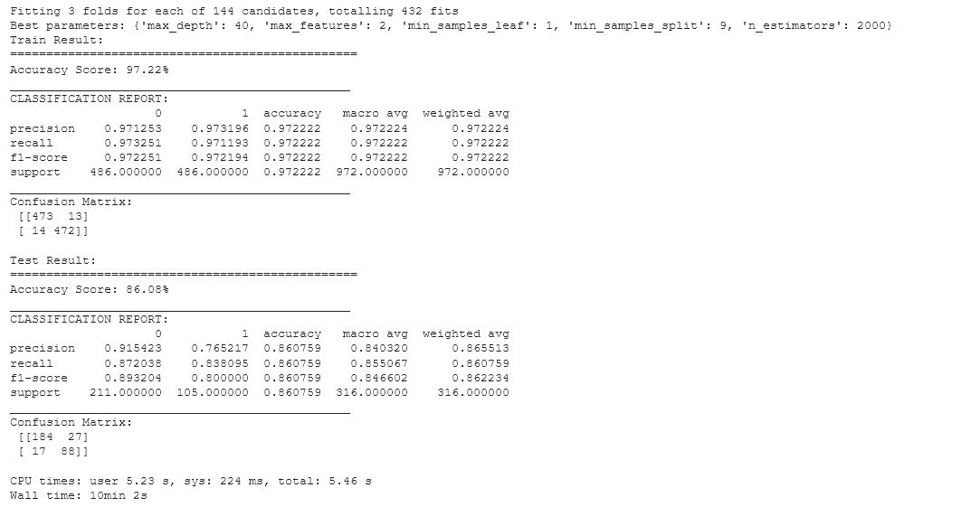
testing results - Random Forest

Slide 21
Conclusion
In this project, our objective was to make sure we have a reliable model that can be used in order to determine if a substance is biodegradable or not.
I conclude that the best type of model for this problem is a Support Vector Machine (SVM) model with an accuracy of 89.24%
Model is trained on a balanced class dataset, using Oversampling with the Synthetic Minority Oversampling Technique (SMOTE)
This model could be used as a Proof of Concept for the use of simulation on compounds to determine whether it is biodegradable or not.

